Slide 1
Milk Quality Prediction
Group 2
Kulaphong Jitareerat
Nijiati Abulizi

Slide 2
Introduction:
Exploratory Data Analysis
Methods
Modelling Flow
Data Preprocessing
Performance Evaluation
Recommendation

Slide 3
Data Set
Quantitative
pH (3 to 9.5)
Temperature ( 34’C to 90'C)
Color (240 to 255)
Qualitative
Taste (0/Bad or 1/Good)
Odor (0/Bad or 1/Good)
Fat (0/Low or 1/High)
Turbidity (0/Low or 1/High)
Grade (Target: Low/Bad or Medium/Moderate, High/Good) / Target

Slide 4
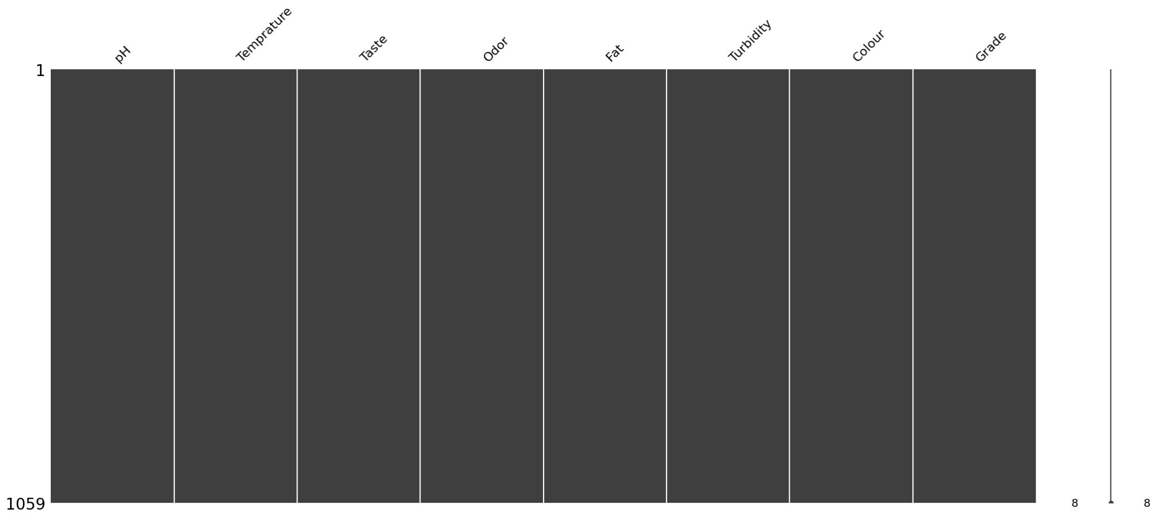
No Missing Data Points Found

Slide 5
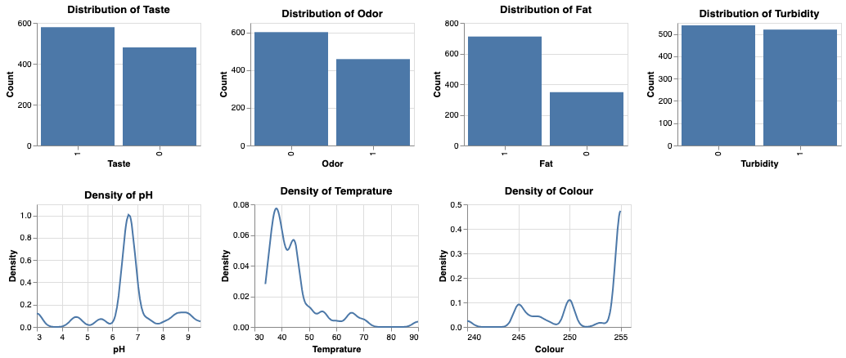
Categorical and Numerical Data Distributions

Slide 6
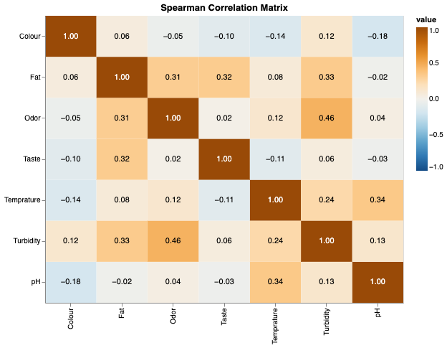
Turbidity is Correlated with Odor

Slide 7
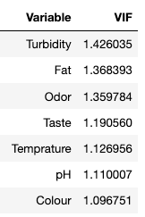
Check Multicollinearity

Slide 8
Method: Modelling Flow
Training Models
Tune Hyperparameters
with
5-Folds Cross Validation and
GridSearch
CV
Performance
Splitted Data
Train: 80%
Test: 20%
Training Data
The Best Parameters
Data
Splitting
Data
Preprocessing
Training Data
Re-Train Model
Test
Evaluation
Data
Preprocessing
Test
Performance
Raw Data
Train
Performance
Apply to Testing Dataset
Testing Data

Slide 9
Data Scaling and PCA Transformation for Sensitive Models
Training Models
Logistic Regression
LDA
QDA
Naive Bayes
KNN
Random Forest
AdaBoost
SVM
PCA
Scale Data
(Standard Scaler)
Split Data

Slide 10
Algorithm | Multicollinearity | Scaling | Reasons for Multicollinearity | Reasons for Scaling
Quadratic Discriminant Analysis | High | High | Assumes normality and independence; highly sensitive to correlated predictors. | Involves calculation of covariance matrices; benefits from consistent feature scales.
Logistic Regression | High | High | Linear model; sensitive to correlated predictors; assumption of independence. | Log-odds interpretation; coefficients sensitive to feature scales.
Linear Discriminant Analysis | High | High | Assumes normality and independence; sensitive to multicollinearity. | Involves covariance matrices; benefits from consistent feature scales.
Support Vector Machine | Low | High | Kernel-based; sensitive to distance metrics; benefits from scaled features. | Relies on distance metrics; improves convergence and performance with scaled features.
Naive Bayes | Low | Low | Conditional independence assumption; less affected by correlated features. | Probability-based; robust to feature scales, but may not benefit from scaling.
AdaBoost | Low | Low | Boosting ensemble; relatively robust to multicollinearity. | Weak learners compensate for issues; scaling may not be critical.
K-Nearest Neighbors | Moderate | High | High sensitivity to distances; affected by feature correlations. | Distance-based algorithm; requires normalized feature scales.
Random Forest | Moderate | Moderate | Ensemble method; less sensitive, but may still be affected by correlated features. | Decision trees are less sensitive to feature scales; minimal impact.

Slide 11
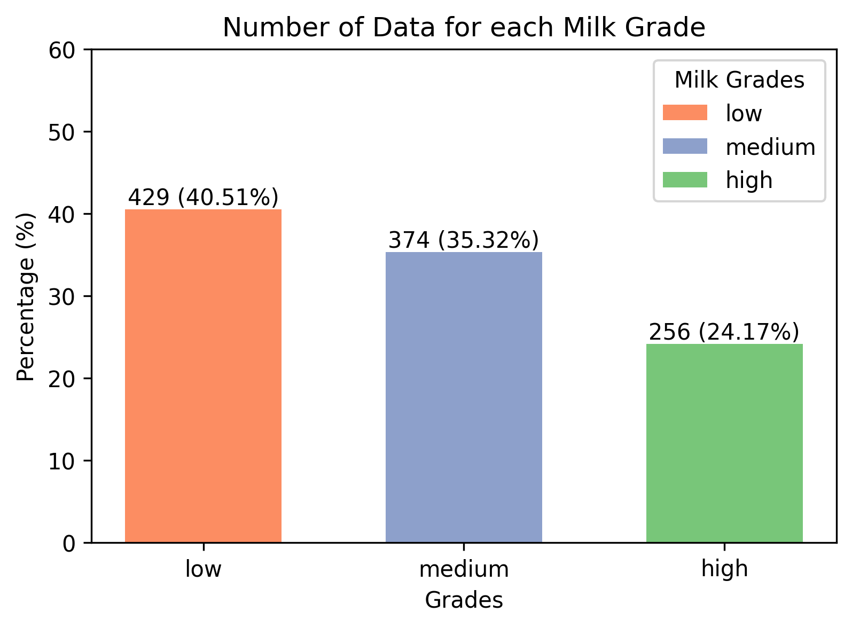
Why we used “F1-Score” metric
Imbalance in each grade
Interested in both Precision and Recall
Notes:
Before we show the model performance, we decided to use F1 Score metric as our tool for select the best model because of 2 reasons.
Firstly, Imbalance.
Secondly, the Recall and Precision.
Precision: This measures the accuracy of the positive predictions made by the model. It is the ratio of true positive predictions to the sum of true positives and false positives. In simpler terms, it answers the question, "Of all the items predicted as positive, how many were actually positive?"
Precision = True Positives/True Positives + False Positives
Recall (or Sensitivity): This measures the ability of the model to capture all the relevant instances of the positive class. It is the ratio of true positive predictions to the sum of true positives and false negatives. In simpler terms, it answers the question, "Of all the actual positive instances, how many did the model correctly predict?"
Recall = True Positives/True Positives + False Negatives
The F1 score is the harmonic mean of precision and recall and is calculated using the formula:
F1 = 2 × (Precision × Recall / Precision + Recall)

Slide 12
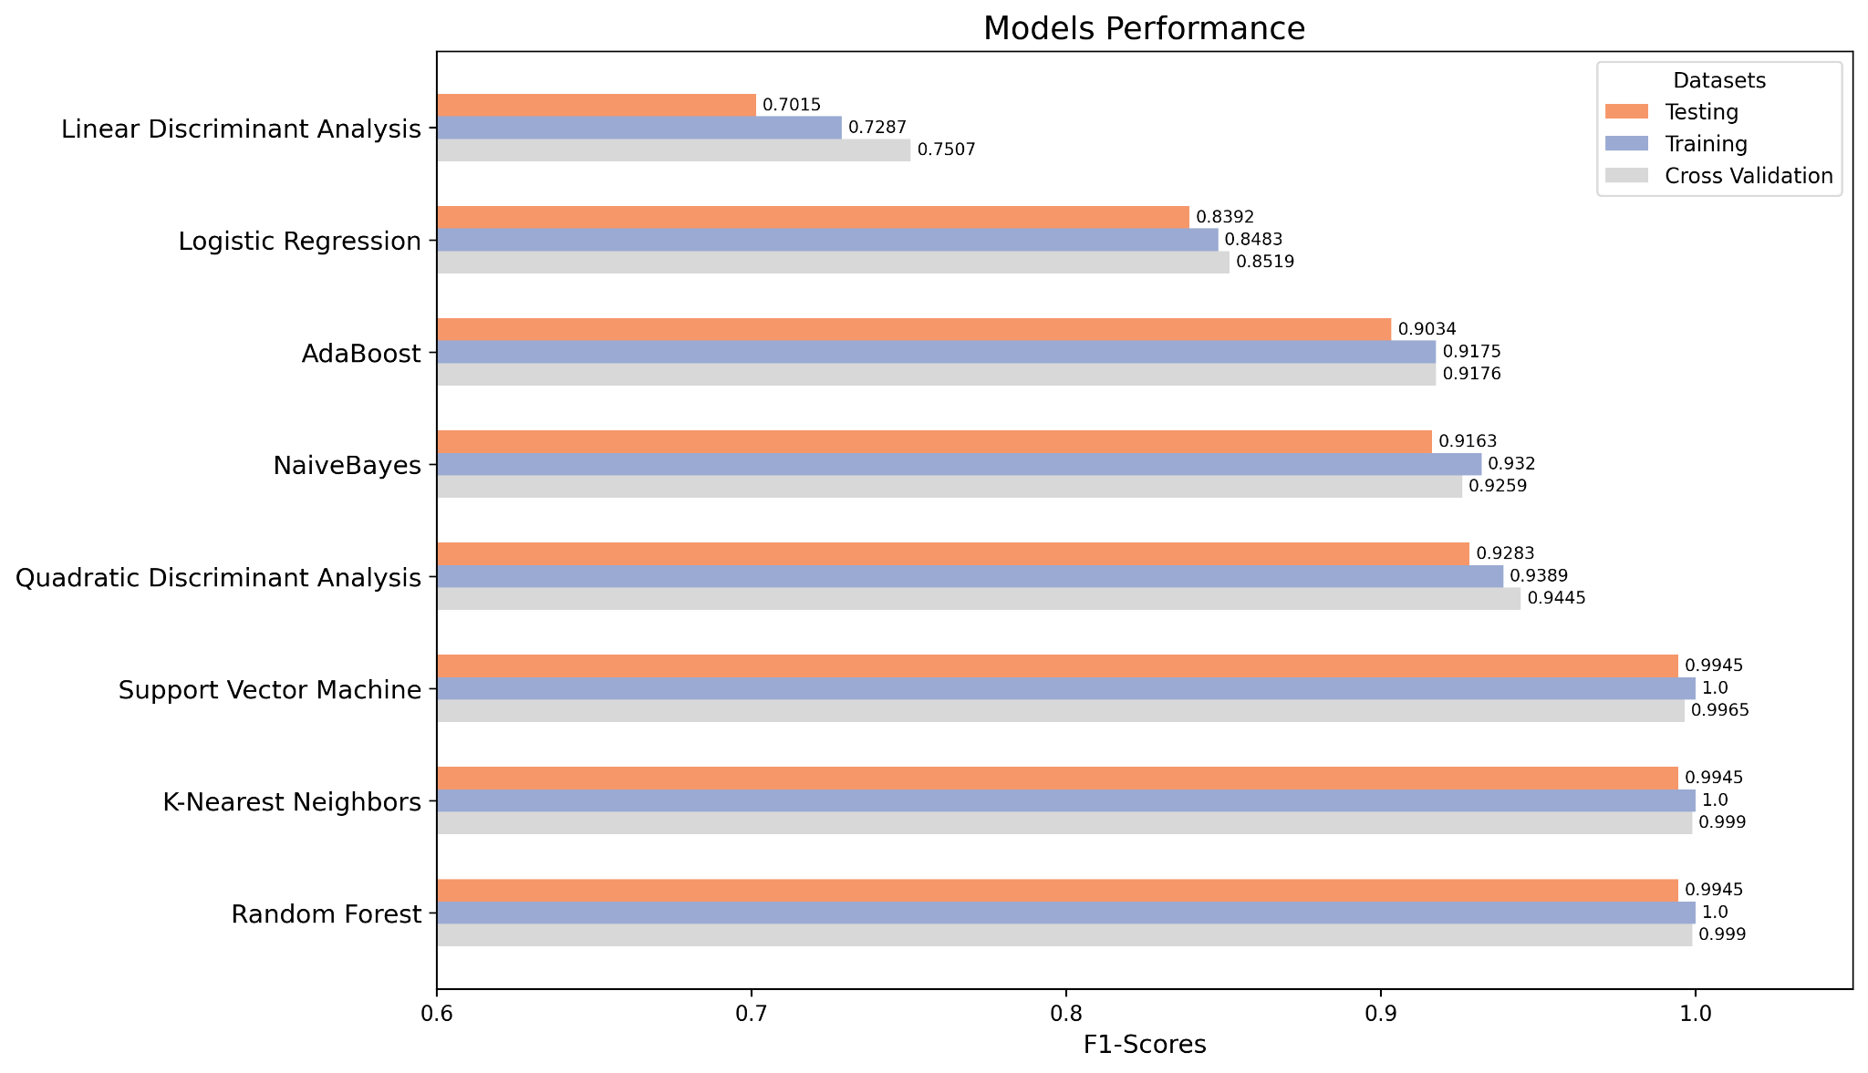
Performance of Models after Scaling
Notes:
These are the performance for each model with the only scaling input.
The top 3 models performance are SVM, KNN, and Random Forest. They have F1-scores around 0.99.

Slide 13
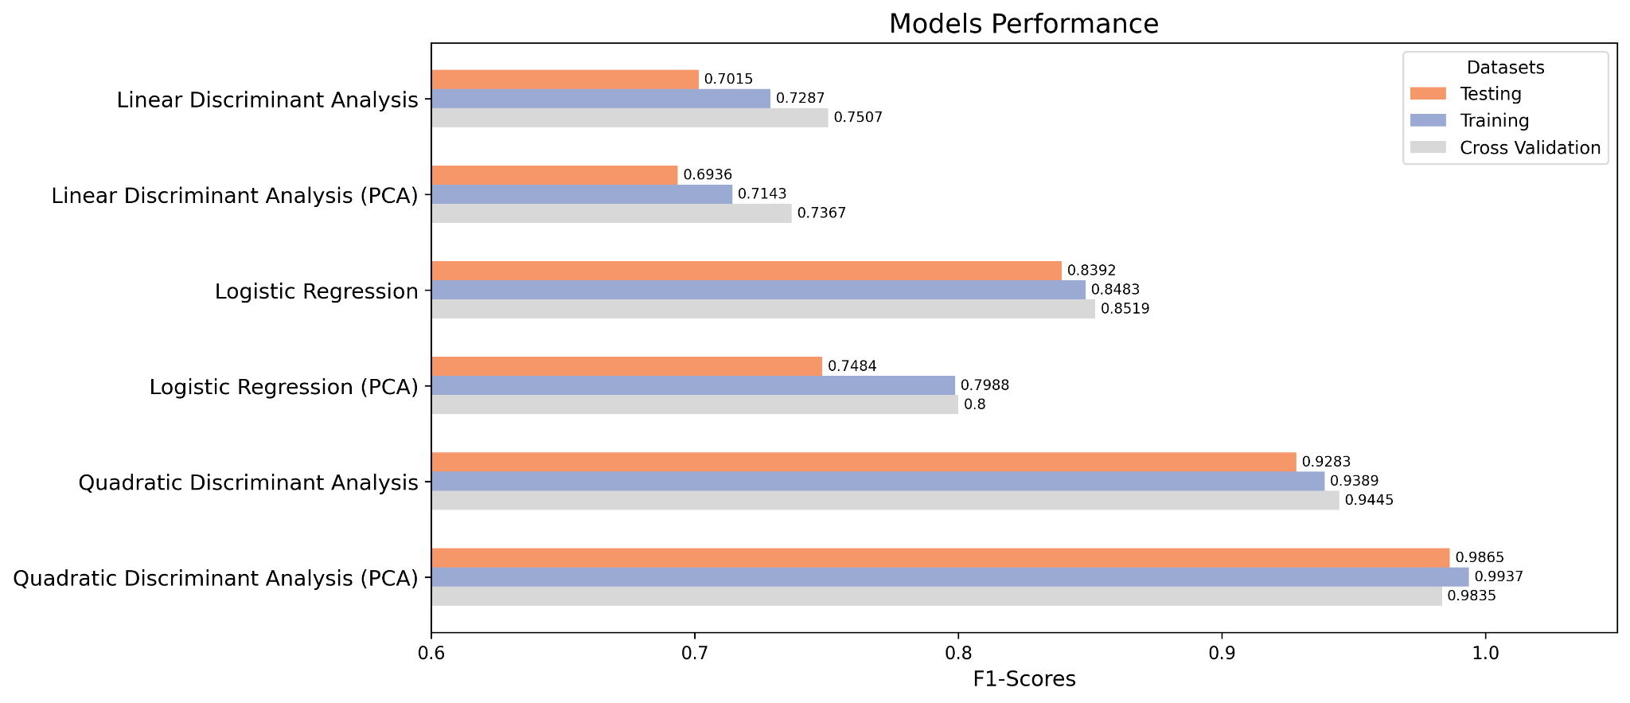
Multicollinearity Consideration for Sensitive
Models (LDA, QDA, Logistic Regression)
93% of Variance Retained While Reducing Collinearity
Notes:
As our assumption, we did experiment about applying PCA to reduce multicollinearity of features.
Our retained the variance is 93%.
We get this number from trying to pass the warning of the QDA library.
The result show that the QDA could rift up the score significantly, which is about 6%.
1. The model probably is robust to variations. 2. Even after transformation, PCA still captured the most important features of the data which is similar to the original. 3. PCA is able to reduce dimension without significant loss of original information.
I would remove the 100%, because it is still giving the warning. We can just keep the 93% which removes the warning.
Because at 94%, it is still giving us the colinear warning
Collinearity in statistical models occurs when predictor variables are highly correlated, leading to unstable coefficient estimates, difficulties in interpretation, increased standard errors, and a higher risk of overfitting. To mitigate these issues, solutions include removing collinear variables, applying regularization (Ridge or Lasso), or using Principal Component Analysis (PCA) for dimensionality reduction. Addressing collinearity is essential for reliable and interpretable modeling.

Slide 14
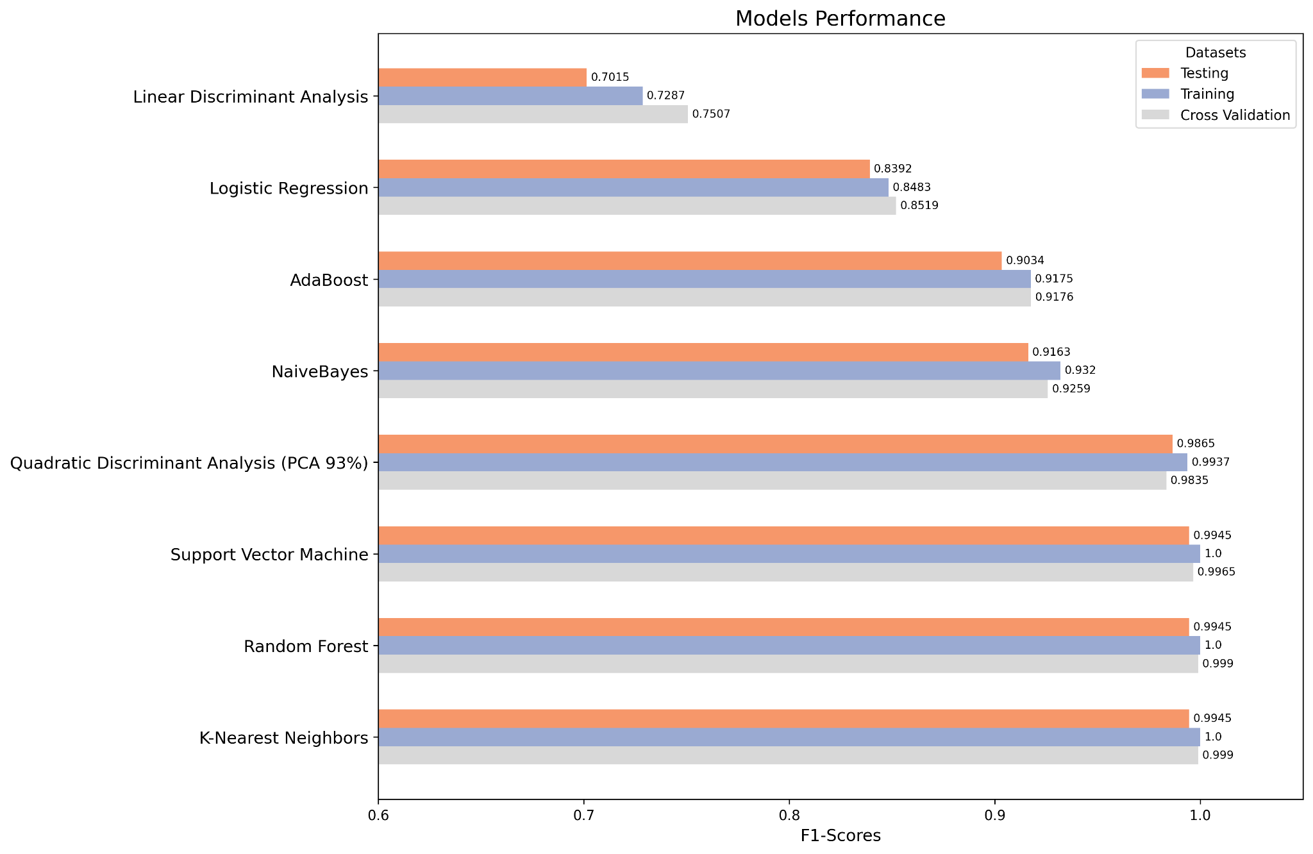
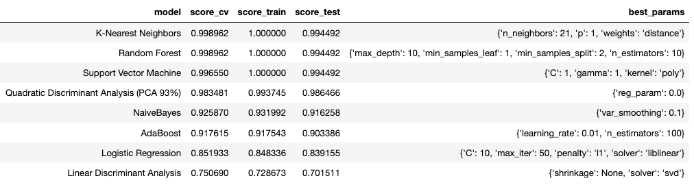
The Best of Each Model
The Best
Notes:
This slide shows about the best of each model type after doing experiment of tuning Hyperparameters and Data preprocessing
Even though the performance of QDA increase remarkably, it still cannot win the top 3 model, which are SVM, KNN and Random Forest.
And for parameters of those model can be seen in the table.

Slide 15
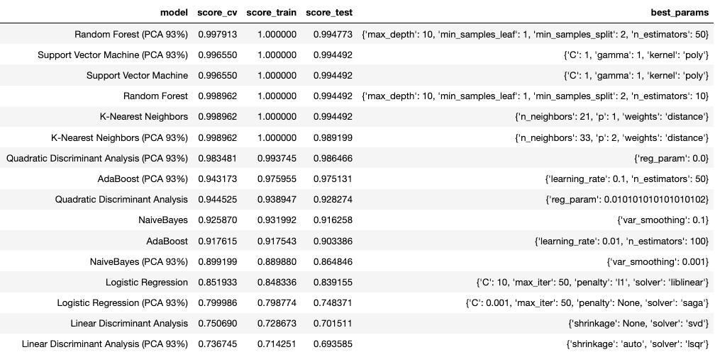
Compare PCA vs Non-PCA

Slide 16
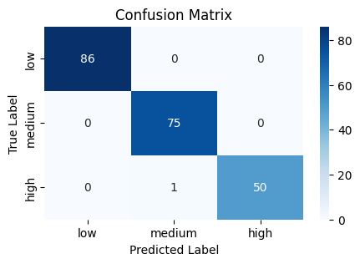
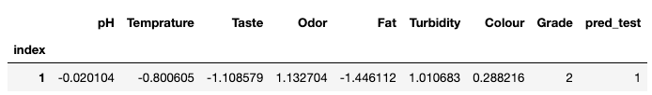
The incorrect prediction
Confusion Matrix of Testing dataset
Random Forest
Confusion Matrix of Testing dataset
KNN

Slide 17
Recommendation
Random Forest
Pros
Insights into the importance of each feature
Robustness against overfitting
Cons
Interpretability might still be a challenge due to the ensemble of trees
K-Nearest Neighbors
Pros
Simple and quick to implement
Interpretability
Cons
Scalability as the dataset grows
Sensitive to outliers

Slide 18
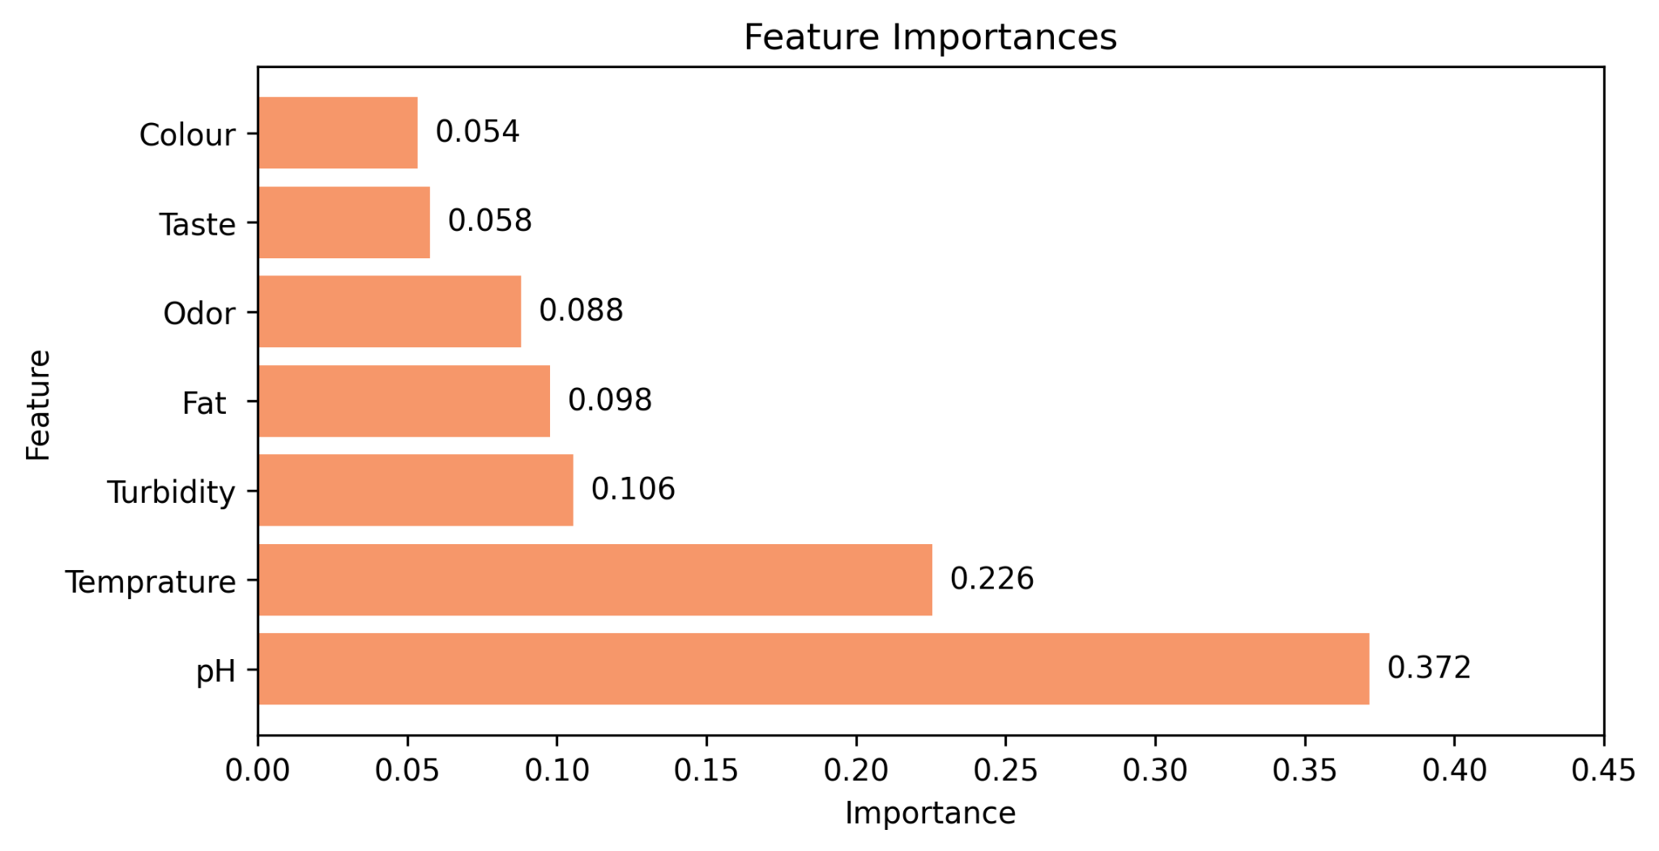
Insight from Random Forest Model

Slide 19
Thank You
Questions?

Slide 20


